Slide 1
Using DI and IOC: Mocking and Testing

Slide 2
About me:
Application/Cloud Architect UMB
20+ years of software development
First program on Apple II in 4th grade (8 years old)
Cobol, Fortran, Mark IV
VB6, VBS, VBA, VB.NET, C#, JavaScript
.NET Framework 1-4, .NET Core 1-2
Node.JS
JQuery, Angular, Bootstrap, etc.
Higher education, Banking and Finance, Legal Discovery, CRM, Advertising
Married HS sweetheart (met at 15, married at 19, married 29 years)
One son, currently in Medical School ($$$$$)
YASDB (Yet Another Software Development Book)

Slide 3
Contact
GitHub: https://github.com/flipthetrain
https://github.com/flipthetrain/softwarechange
Twitter: https://twitter.com/flipthetrain
Facebook: https://www.facebook.com/flipthetrain
Gmail: flipthetrain@gmail.com

Slide 4
Book Title Designing, Building, Testing, and Managing Software Through Change using C#

Slide 5
Designing, Building, Testing, and Managing Software Through Change using C#
Object Design
Application Object Design
Retention Object Design
Execution Object Design
Communication Object Design
Object Versioning
Application Design
Communication Layer
Orchestration Layer
Execution Layer
Retention Layer
Code File Design
Code File Types
Code File Elements
Element Naming
Access Levels
Inheritance
Design Patterns
Bridge Pattern
Command Pattern
Strategy Pattern
Singleton Pattern
Factory Pattern
Adapter Pattern
Facade Pattern
Builder Pattern
Dependency Injection Pattern
Inversion of Control Pattern
Testing
Unit Testing
Integration Testing
UI Testing
Source Control Management
SCM Systems
Branching
Merging
Releases
Deployment Management
Environments
Approvals
Auditing
Validation
Rollback

Slide 6
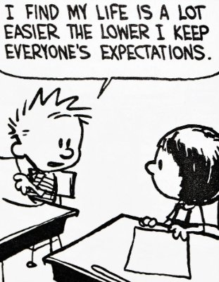
Expectations of this Talk
IS NOT…
This IS NOT a source to Copy/Paste Code into your project!!!
This IS NOT the only way to do DI or IOC!!!!
This IS NOT the best way to do DI or IOC!!!!
This IS NOT the only way to Mock or Test!!!!
This IS NOT the best way to Mock or Test!!!!
IS….
A conversation to get you TO THINK about DI and IOC
A conversation to get you TO THINK about Mocking and Testing
A conversation to get you TO SHARE your ideas with me and others

Slide 7

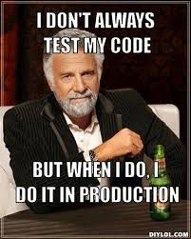
Main Event

Slide 8
3 Types of Software Engineering Abstractions
Structural Abstractions (What)
What the objects and methods want to process data
Shape of objects (public properties, methods, enums, etc.)
Shape of execution (parameters, return types, etc.)
Functional Abstractions (How)
How the program works (algorithms, order of execution, problem dissection)
Implementations of objects (code specific processing)
Conceptual Abstractions (Why)
Why the developer organized code and processing (private properties, methods, enums, etc.)
Variable and Method naming

Slide 9
DI and IOC
Using DI and IOC are structural abstractions
How you implement and use DI and IOC are functional abstractions
Frequently used together (kissing cousins)
May be used separately
Distinctly different techniques
Multiple ways to do each

Slide 10
What is DI? (Dependency Injection)
A method of software engineering where one object supplies the dependencies of another object.
A dependency is an object that contains data or processes that another object needs
Injection is the act of passing the dependency to the dependent object (frequently via the constructor) rather than the dependent object creating the dependency internally.
Dependency
Object

Slide 11
DI in C#
public class DependentObject
{
public DependentObject(DependencyObject Dependency)
{
… do magic
}
… do more magic
}
Public class DependencyObject
{
… do magic with properties, methods, etc that do work that the dependent object needs
…(i.e. configuration parameters, connection strings, initialization data, etc.)
}
DependencyObject dependency=new DependencyObject()
DependentObject dependent=new DependentObject(dependency)

Slide 12
What is IOC? (Inversion of Control)
A method of software engineering where object coupling bound at runtime as opposed to compile time.
Implementation 1
Interface
Or
Abstract Class
Implementation 2
Implementation 3

Slide 13
IOC in C#
public interface IMyInterface
{
… do magic
}
public class MyClass1 : IMyInterface
{
… do magic
}
public class MyClass2 : IMyInterface
{
… do magic
}
Public class MyClass3 : IMyInterface
{
… do magic
}
IOCContainer myContainer=new IOCContainer();
myContainer.Bind<IMyInterface,MyClass1>().Named(“1”);
myContainer.Bind<IMyInterface,MyClass2>().Named(“2”);
myContainer.Bind<IMyInterface,MyClass3>().Named(“3”);
string yourChoice=console.readline();
IMyInterface myClass=null;
myclass=myContainer.Get<IMyInterface>()
.ByName(yourChoice);
Or
public class AnotherClass
{
public AnotherClass(IMyInterface myClass)
{
… do magic
}
… do other magic
}

Slide 14
What is Testing?
A method of software engineering of writing a dedicated program to validate the correct processing of another program
Unit Testing is used to validate an individual package of code (frequently a single method and frequently devoid of external dependencies).
Integration Testing is used to validate a process that requires several packages of code to work together in a specific sequence (may include limited external dependencies).
Regression Testing is used to validate full software end to end processes and all dependencies meet business requirements.
Performance / Load Testing is used to validate a system can execute successfully within given time and resource constraints with a large number of requests or a large amount of data.

Slide 15
Testing in C#?
public int Add(int term1, int term2)
{
return term1+term2;
}
public void Given_2Terms_When_Add_ShouldReturn_SumOfTerms()
{
int expected=5;
int term1=2;
int term2=3;
int actual=Add(term1,term2);
Assert.AreEqual(actual,expected);
}

Slide 16
What is Mocking?
A method of software engineering whereby one object or method simulates the behavior of another object or method and is transparent to the underlying system.
Frequently used to remove external dependencies for Unit Testing
May be used in development or deployed when an external dependency is not available
May be used when simplified processing is sufficient

Slide 17
Mocking in C#
public class MyClass
{
public virtual int ComplexCalculation(int p1, int p2, int p3)
{
… do magic
}
}
public class MyClassMock : MyClass
{
public override int ComplexCalculation(int p1, int p2, int p3)
{
return 1;
}
}
public int DoWork(MyClass myClass)
{
return myClass.ComplexCalculations(1,2,3);
}

Slide 18
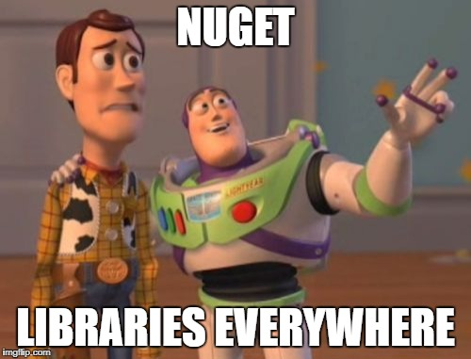
Lots of Libraries
DI/IOC
Castle
Structure Map
Spring.NET
Autofac
Unity
Ninject
LinFu
DIY
Testing
MSTest
NUnit
Fuchu
DIY
Mocking
FakeItEasy
NSubstitute
JustMock
Moq
DIY

Slide 19
DI and IOC more than just mocking and testing
Aspect Oriented Programming (AOP)
Event Management
Command Pattern
Lambda Composition
State Management
Functional Programming
Many more…

Slide 20
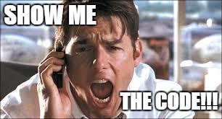
Let’s see the freaking code already!!!!

Slide 21
Switch to
Visual Stupid Slow

Slide 22

The true reason why we are here Prizes and Beer!!!

